Slide 1
Web Scraping
Using Python

Slide 2
Learning Objective
Define web scraping and explain its purpose in data collection and analysis.
Identify ethical and legal considerations when scraping websites, including responsible usage and respect for site policies.
Distinguish between static and dynamic websites, and understand which tools are appropriate for each.
Describe the structure of HTML documents, including common tags and attributes used in scraping.

Slide 3
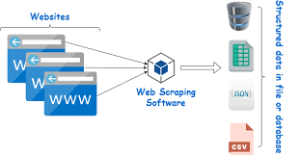
What is Web Scraping?
Web scraping is the automated process of collecting information from websites. Instead of copying data manually, a scraper reads the HTML structure of a webpage and extracts relevant content (like prices, headlines, or reviews) into a structured format (like CSV or JSON).

Slide 4
When and Why to Use Web Scraping
Web scraping is useful when:
Manual collection is impractical (e.g., thousands of product listings).
APIs are unavailable or limited.
Real-time or large-scale data is needed for:
        Market research
        Price comparison
        Academic studies
        Trend analysis

Slide 5
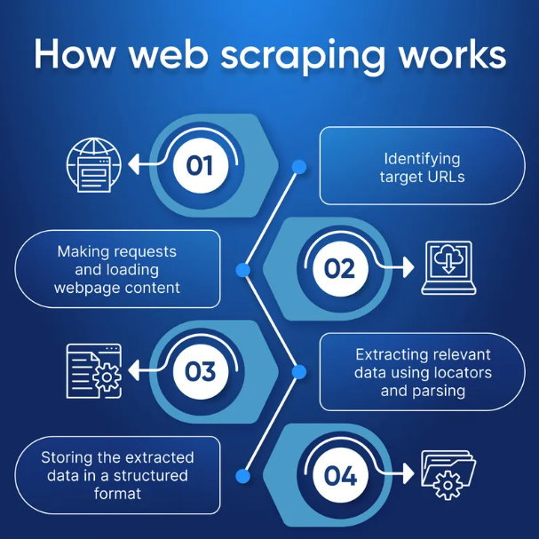
How it works ?

Slide 6
Legality and Ethics
Web scraping exists in a gray legal zone:
Always check the site’s Terms of Service.
Avoid scraping:
  Copyrighted content
  Personal data
  Sites that explicitly block bots (via robots.txt)
Be polite: don’t overload servers with rapid requests.

Slide 7
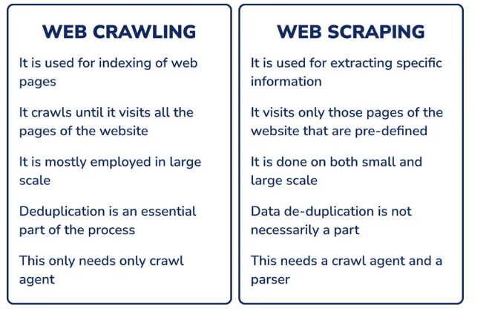
Web Crawler vs Web Scraper

Slide 8
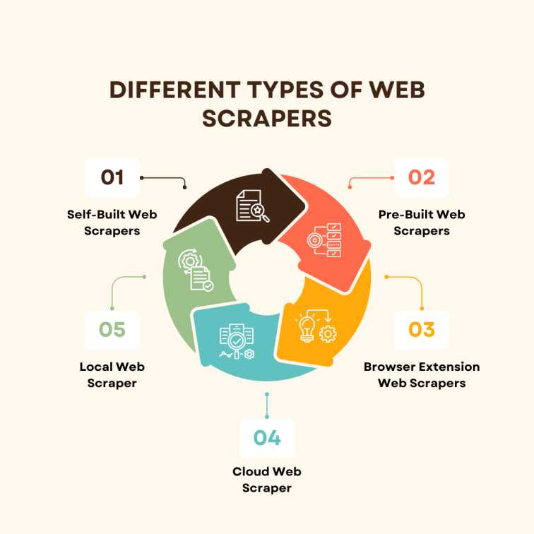
Types of Web Scrapers

Slide 9
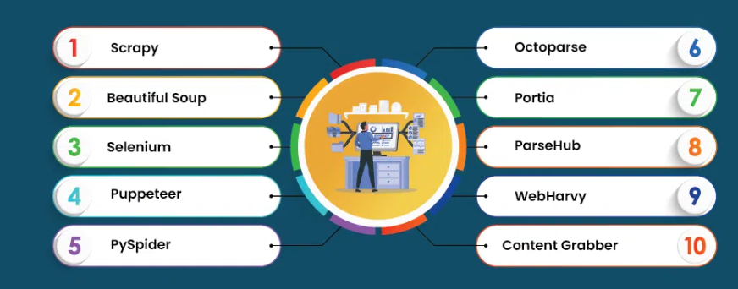
Frameworks for Web Scraping

Slide 10
Installation and Setup
!pip install requests beautifulsoup4 lxml

Slide 11
Understanding HTML Structure
Webpages are built with HTML tags:
<div>, <a>, <span>, etc.
Tags have attributes like class, id, href.
Scrapers locate data by targeting these tags and attributes.

Slide 12
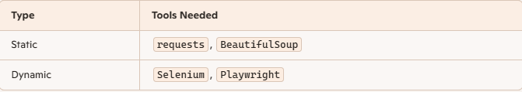
Static vs Dynamic Websites
Static: HTML is fixed and visible in page source.
Dynamic: Content is loaded via JavaScript after page load.

Slide 13
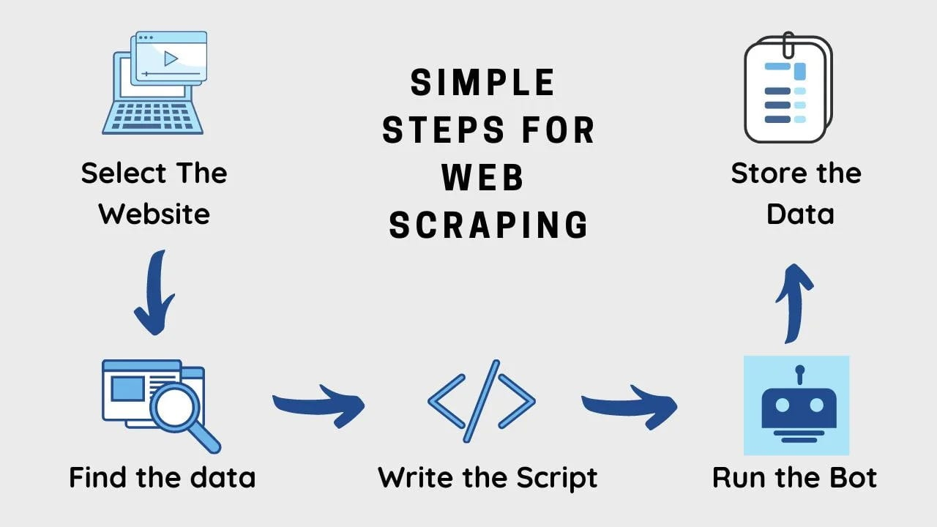
Workflow
Identify target data
Download HTML (via requests)
Parse HTML (via BeautifulSoup)
Extract data (tags, attributes)
Store data (CSV, JSON, DB)

Slide 14
The Requests Library
import requests
response = requests.get("https://example.com")
Sends HTTP requests (GET, POST)
Returns response.text (HTML content)

Slide 15

Beautiful Soup Introduction
from bs4 import BeautifulSoup
soup = BeautifulSoup(html, "lxml")
Parses HTML into a navigable tree
Allows searching by tag, class, id, etc.

Slide 16
Finding Elements with Beautiful Soup
soup.find('div') # First match
soup.find_all('a') # All <a> tags
soup.select('.class') # CSS selector

Slide 17
Extracting Data from Elements
element.text # Inner text
element['href'] # Attribute value
Use .text for content
Use ['attr'] for links, IDs, etc.

Slide 18
What is pagination in web scraping
Pagination in web scraping refers to the process of navigating through multiple pages of a website to collect data that is spread across those pages.
Why Pagination Matters
Many websites don’t display all their data on a single page. Instead, they break it into chunks—like:
Product listings (Page 1, Page 2…)
Search results
Blog archives
Quote or review pages
To scrape all the data, you need to:
Detect the “Next” button or link
Extract the URL or path it points to
Repeat the scraping process for each page

Slide 19
Handling Pagination
next_page = soup.find('li', class_='next')
next_url = next_page.find('a')['href’]
Many sites split data across pages.
Scrapers must detect and follow “Next” links.

Slide 20
Storing and Exporting Data
Use csv, json, or pandas to save data.
Enables reuse in analysis, dashboards, or ML models.

Slide 21
Coding Examples
Basic Web Request
import requests
url = "https://quotes.toscrape.com/"
response = requests.get(url)
print(response.text)

Slide 22
Coding Examples
Parsing HTML with Beautiful Soup
from bs4 import BeautifulSoup
soup = BeautifulSoup(response.text, "lxml")
print(soup.title)

Slide 23
Coding Examples
Find All Elements by Tag
quotes = soup.find_all('span', class_='text')
for quote in quotes:
print(quote.text)

Slide 24
Coding Examples
Extracting Attributes
links = soup.find_all('a')
for link in links:
print(link.get('href'))

Slide 25
Coding Examples
Using CSS Selectors
quote_texts = soup.select('.text’)
Extracting Author Names
authors = soup.select('.author')

Slide 26
Coding Examples
Handling Pagination
next_page = soup.find('li', class_='next’)
Looping Through Multiple Pages
while next_page:
# fetch, soup, extract...
Saving Data to CSV
import csv
with open('quotes.csv', 'w') as file:
writer = csv.writer(file)
writer.writerow(['quote', 'author'])

Slide 27
Error Handling and Politeness
Why it’s necessary:
Avoids crashing on bad responses
Prevents IP bans by mimicking human behavior
Respects server load

Slide 28
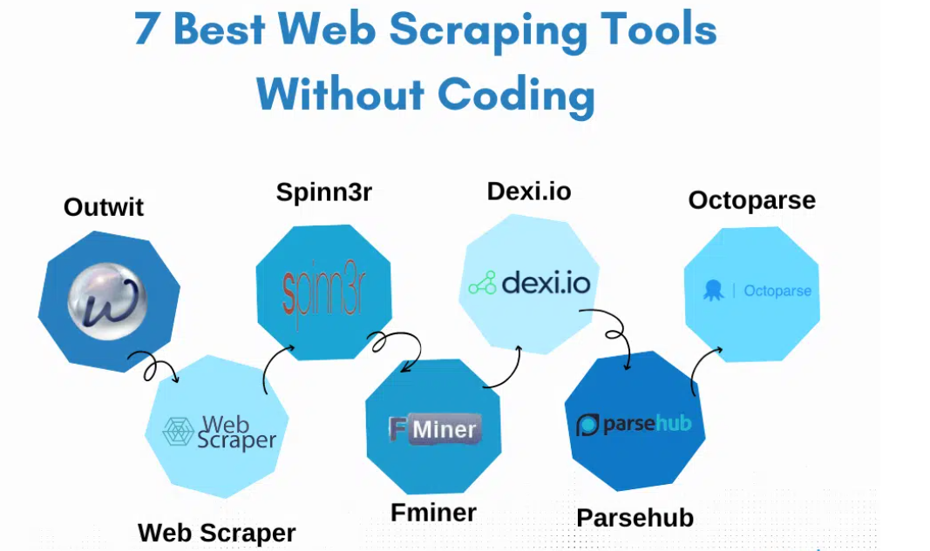

Slide 29


